Slide 1
University’s Mobile App For Equipment Loaning
Team 4 - Abdulmohsen Khashogji, Drithi Iyer, Mariamawit Anteneh, Ram Putrevu

Slide 2
Business Problem
Currently, the department of IT in the School of Business loans equipments to students and faculty through a manual system that requires them to manually check off equipments that are loaned.
This system is not accurate in terms of real-time database updates to see the current inventory status.

Slide 3
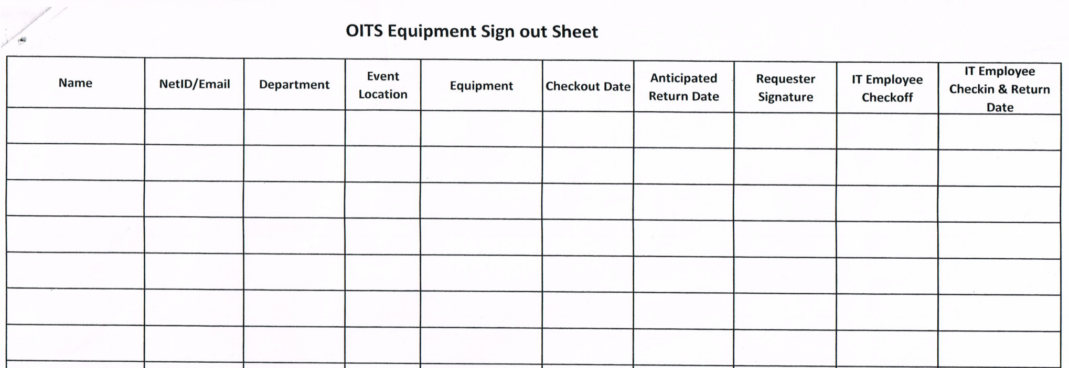

Slide 4
Our Solution
To create a mobile application for students and faculty to check the availability of each equipment and be able to reserve it on the spot.
The application will have forms to fill out any necessary details in order to check out the equipment.
The goal is to completely transform the current system in place to a more advanced system.

Slide 5
Why is this necessary?
Currently, students and faculty are unable to point what equipment is available in advance.
This application can also charge for late returns, loss of equipments and damaged equipments.
Clear and concise database of the equipments available for checkout.
Making this system more streamlined for other colleges in the University to use.

Slide 6
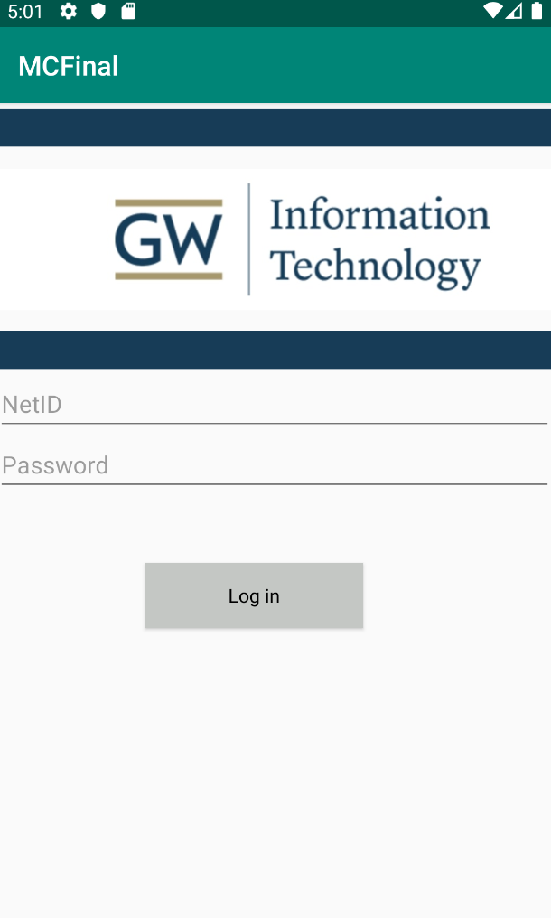
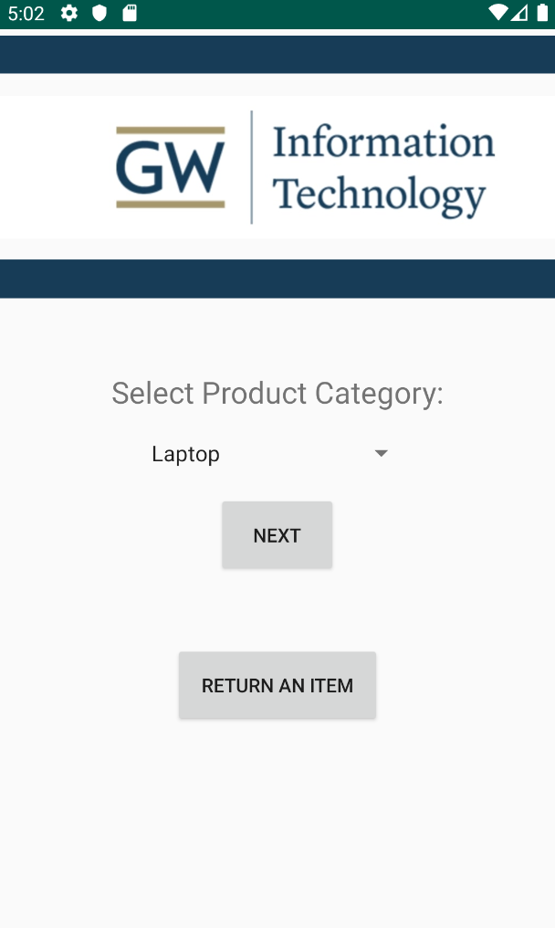
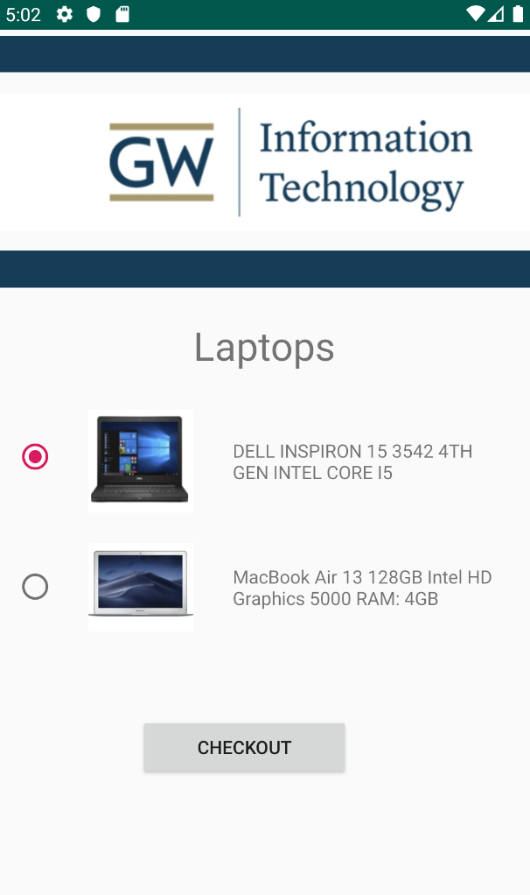
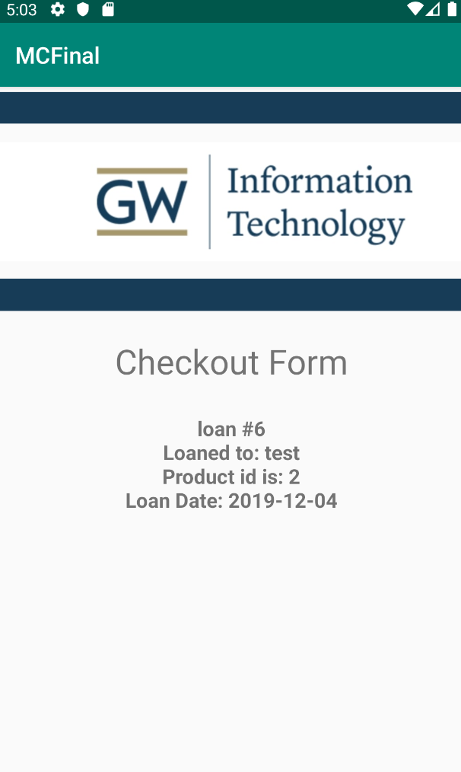
Application Layout

Slide 7
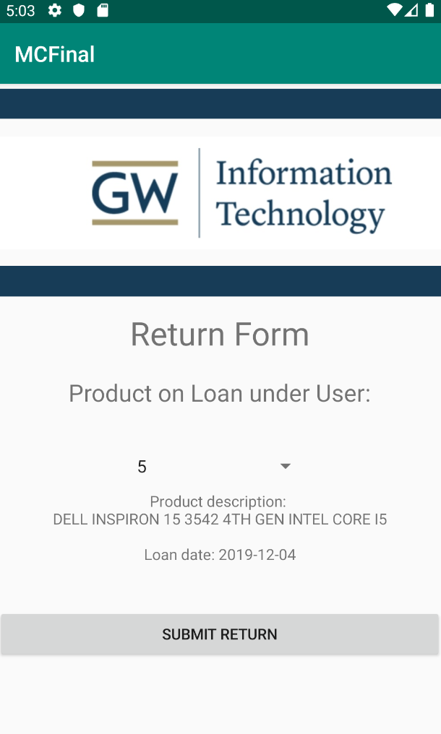
Application Layout

Slide 8
Possible Improvements
Improvement of App functionality such as charging for late returns, tracking of damaged and lost equipments.
Addition of notification setting to remind users of product status.
Updating user profile and history.

Slide 9


